Slide 1

Notes:
Welcome to this presentation of MANIFEST in Mahambo, Madagascar. MANIFEST exists to help people grow into the fullness of who God created them to be. This opening introduces the organisation and the Malagasy context in which our ministries serve.

Slide 2
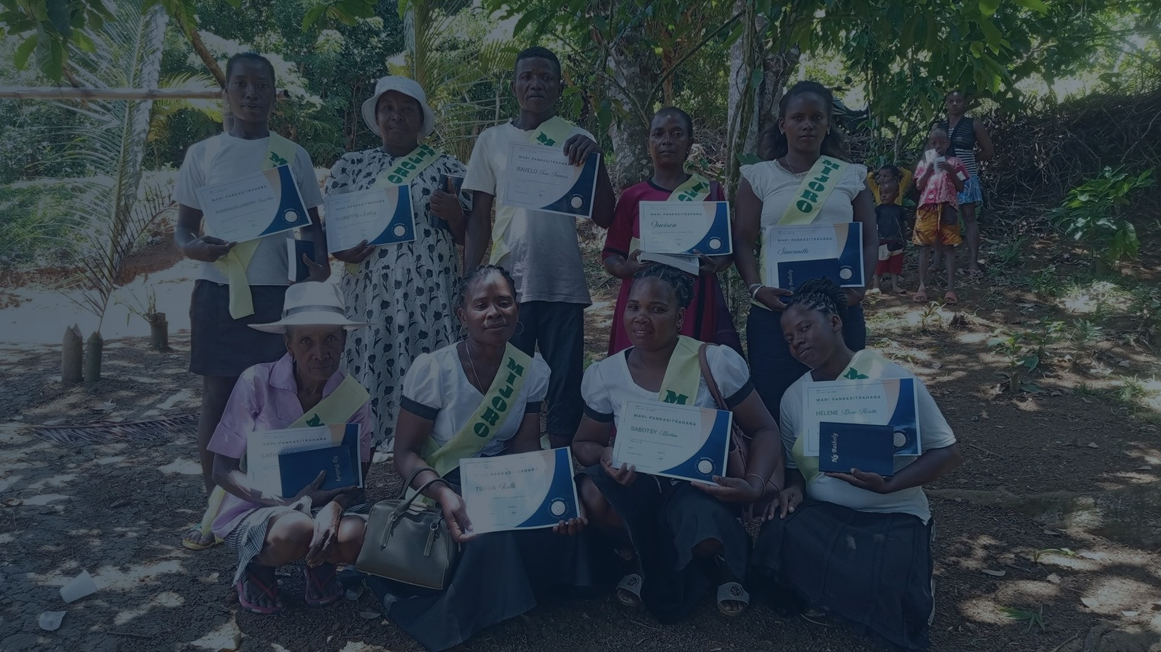


MINISTRY PRESENTATION • KENYA
MANIFEST
Teach. Equip. Empower.
Holistic transformation through the Gospel,
education and practical skills.
MAHAMBO • MADAGASCAR
Presented by Elysé
Notes:
Welcome, and thank you for the opportunity to introduce MANIFEST. Our name expresses our desire to see people become who God created them to be. From Madagascar, we serve children, young people, families, and communities through the Gospel, education, practical skills, and leadership development. Today I will briefly share our vision, the realities we respond to, and how transformation can multiply from one life into an entire community.

Slide 3
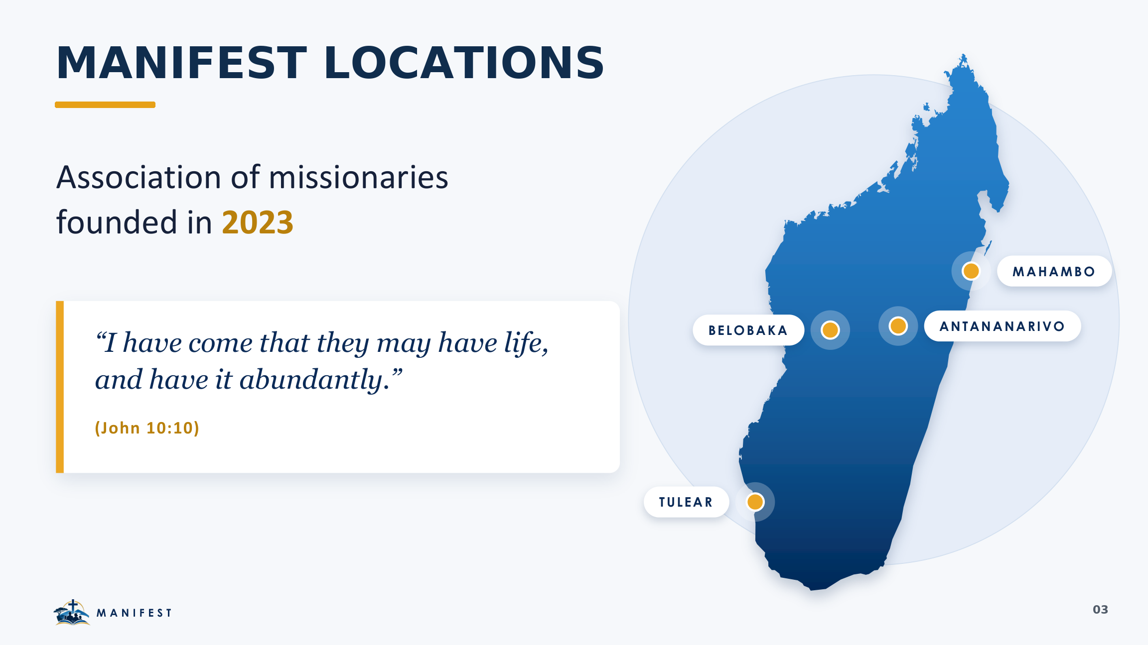
Notes:
MANIFEST is a missionary association founded in 2023 and inspired by John 10:10. Our ministry is active in four Malagasy locations: Antananarivo in Analamanga, Belobaka in Bongolava, Mahambo in Analanjirofo, and Toliara, also known as Tuléar. Each location responds to local needs through a combination of Gospel ministry, education, practical skills, and community support.

Slide 4
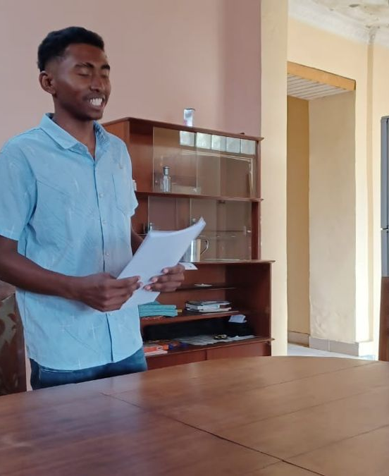
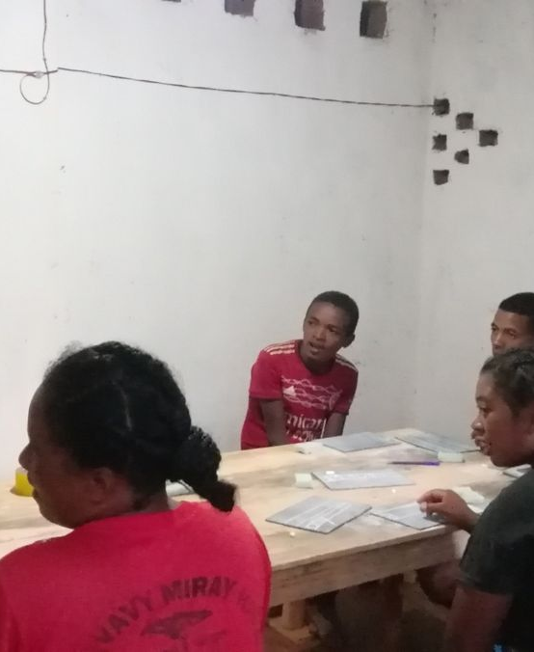
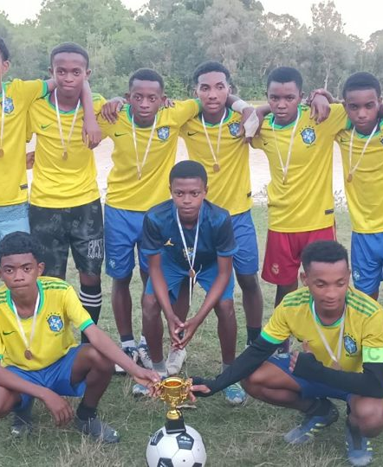
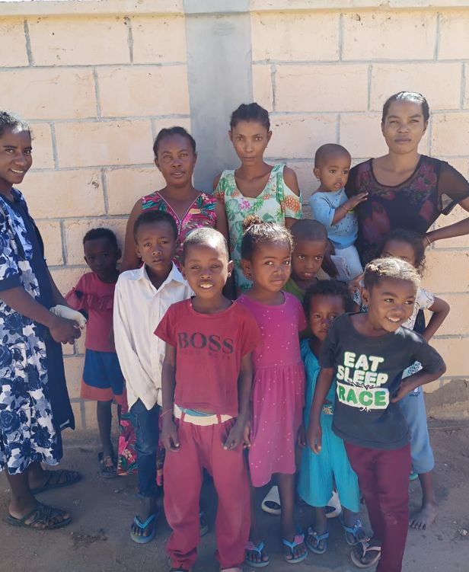
WHO WE ARE
What is MANIFEST?
A missionary association founded in 2023.
ANTANANARIVO • ANALAMANGA
BELOBAKA • BONGOLAVA
English classes and discipleship supporting children, young people, and adults.
Literacy, English, children’s ministry, sport, music, and community outreach.
MAHAMBO • ANALANJIROFO
TOLIARA (TULÉAR) • NID DE L’ESPOIR
Literacy, English, football, digital skills, coding, electronics, identity, and graduations.
Accelerated learning, school meals, and holistic support for out-of-school children.
“I have come that they may have life, and have it abundantly.” JOHN 10:10
MANIFEST • MADAGASCAR
04
Notes:
MANIFEST is a missionary association founded in 2023 and inspired by John 10:10: Jesus came so that people may have abundant life. Our ministries are rooted in four locations. In Antananarivo, we offer English classes and discipleship. In Belobaka, we combine literacy, English, children’s ministry, sport, music, and outreach. In Mahambo, we add football, digital skills, coding, electronics, identity sessions, and graduations. In Toliara, Nid de l’Espoir supports out-of-school children through accelerated learning, meals, and holistic care.

Slide 5
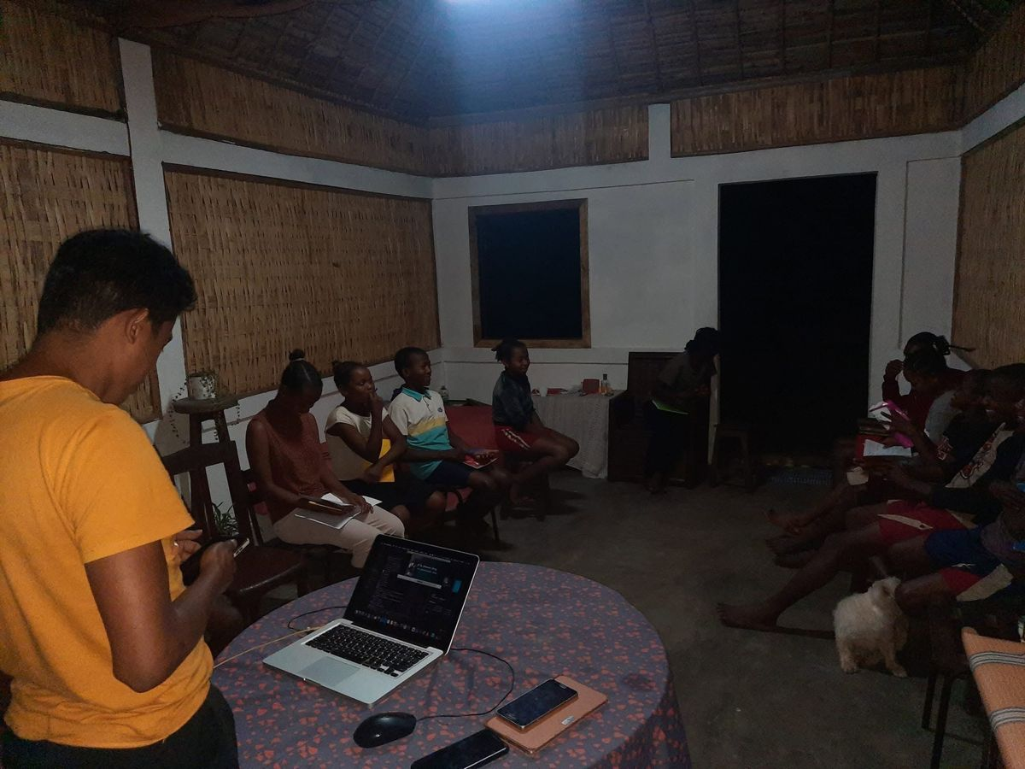
OUR NAME • OUR IDENTITY
A NAME THAT MAPS A JOURNEY FROM IDENTITY TO PURPOSE
WHAT DOES
MANIFEST
MEAN?
MAN
01
INTO
02
A person created in God’s image.
A journey of becoming.
THE FULLEST
03
ESTEEM
04
Our name describes a journey: people discovering their God-given identity, growing into purpose and living with dignity.
Growing toward the fullness of God’s purpose.
Knowing our God-given value and dignity.
IDENTITY. PURPOSE. DIGNITY.
People becoming who God created them to be through the transforming power of the Gospel.
MANIFEST
“I have come that they may have life, and have it abundantly.”
JOHN 10:10
Every programme begins with the person—not the problem.
MANIFEST • MADAGASCAR
05
Notes:
The name MANIFEST carries our identity and maps a journey from identity to purpose. MAN reminds us that every person is created in God’s image. INTO describes a journey of becoming; transformation takes time and relationship. THE FULLEST points toward God’s purpose for each life. ESTEEM means knowing our God-given value and dignity. Together, MANIFEST describes people becoming who God created them to be through the transforming power of the Gospel. This is why every programme begins with the person—not the problem.

Slide 6
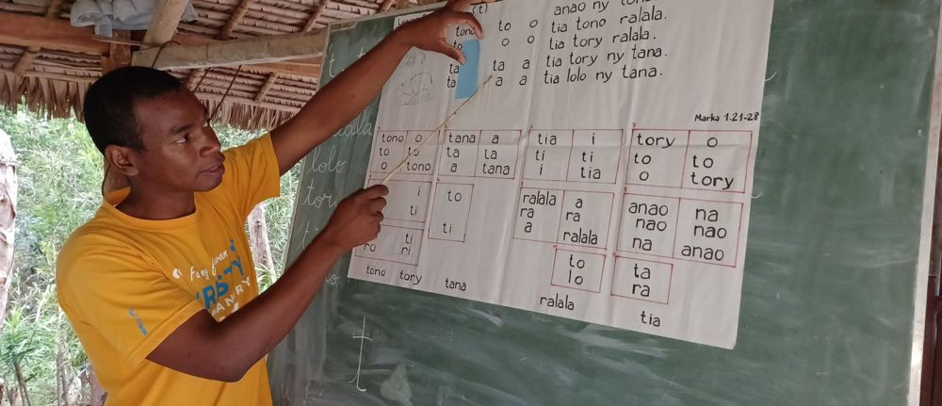
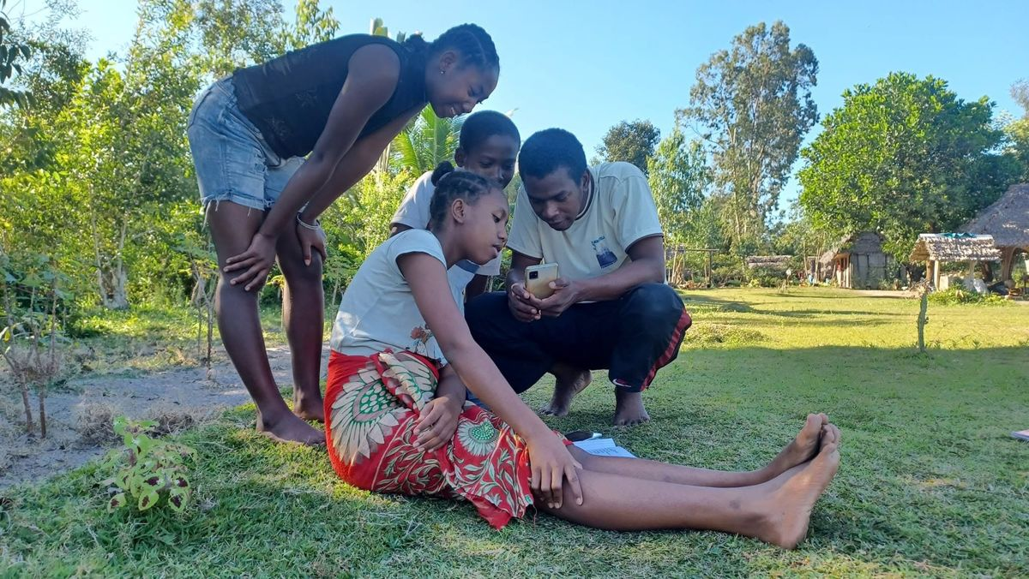
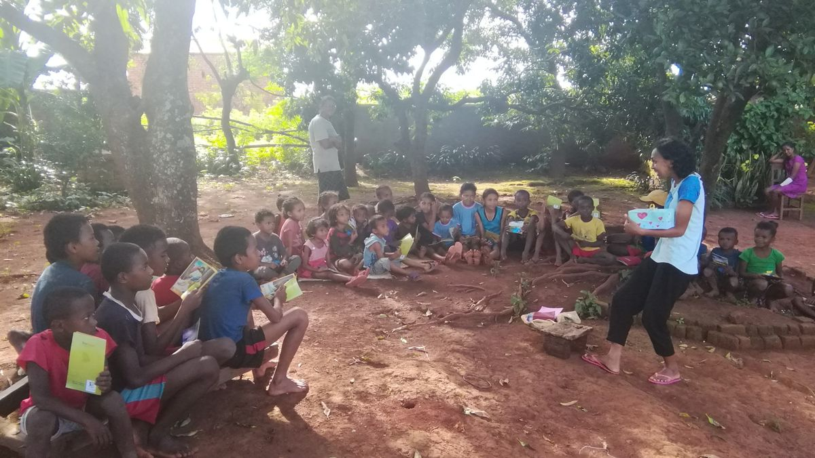
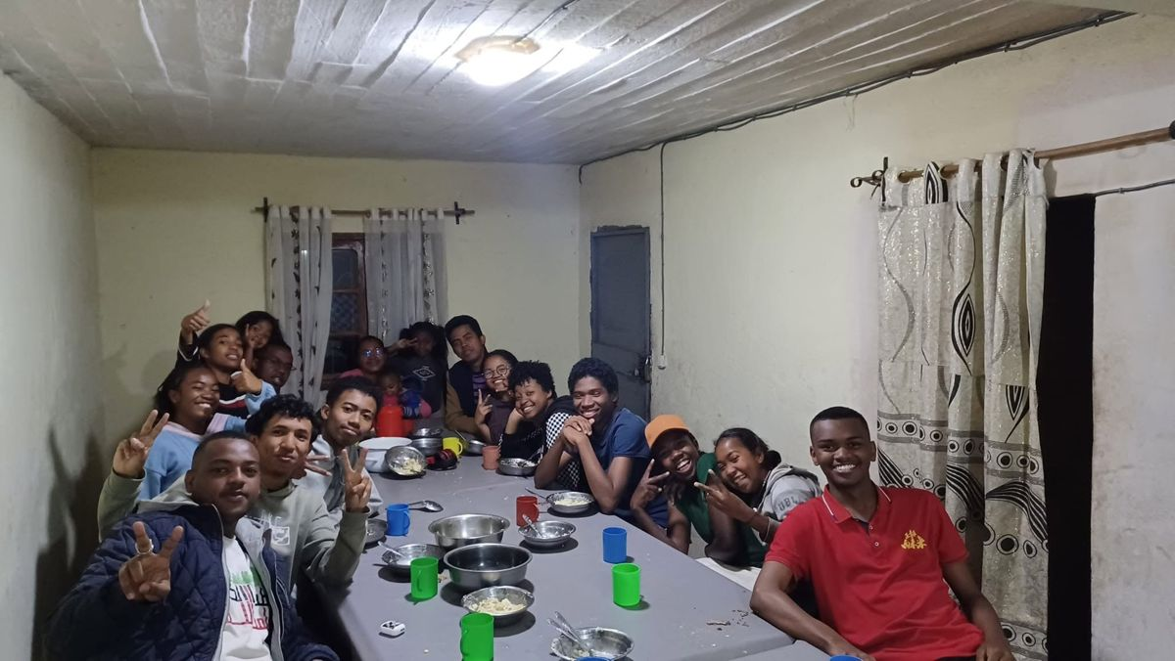
WHY WE EXIST
Our vision and mission
VISION
MISSION
To see marginalised Malagasy children, young people, and families transformed by the Gospel of Jesus Christ. We envision them growing into influential leaders who know God, live abundant lives, and serve as channels of blessing to transform their communities and nation for God’s glory.
To holistically educate, equip, and empower Malagasy children, young people, and families—starting in Bongolava, Analanjirofo, Analamanga, and Toliara. We share the Gospel and provide the foundational education, practical skills, and spiritual training they need to grow in Christ, steward their potential, live with dignity, and become catalysts for a brighter future.
MANIFEST • MADAGASCAR
06
Notes:
Our vision is to see marginalised Malagasy children, young people, and families transformed by the Gospel of Jesus Christ. We want to see them grow into influential leaders who know God, live abundant lives, and bless their communities and nation. Our mission is holistic: we educate, equip, and empower. We combine foundational education, practical skills, and spiritual training so that people can grow in Christ, steward their potential, live with dignity, and become catalysts for a brighter future across Bongolava, Analanjirofo, Analamanga, and Toliara.

Slide 7
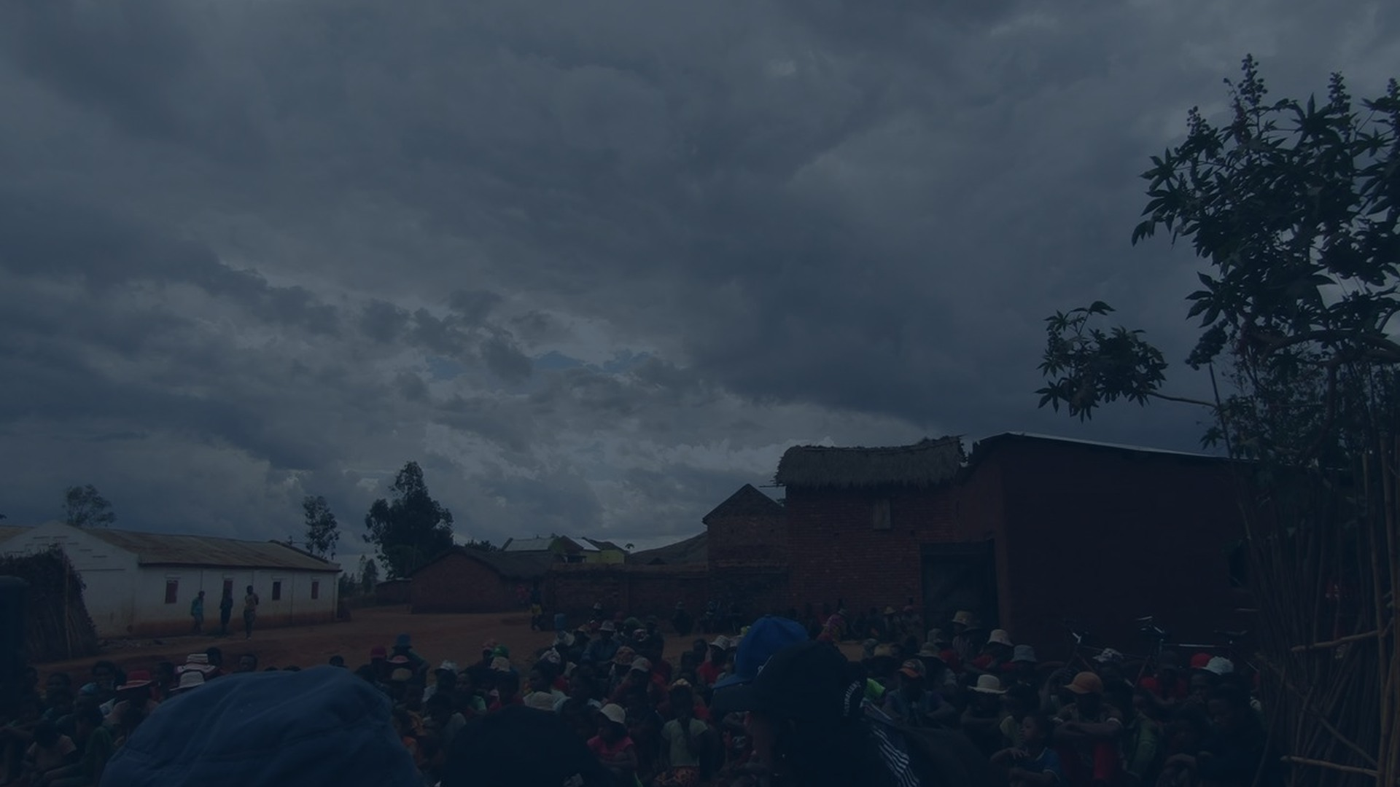
WHERE WE BEGIN
The reality
Every community carries challenges:
But behind every challenge is a person:
Limited opportunities.
01
A person with dignity.
Interrupted education.
Unemployment and economic hardship.
02
A person with potential.
Young people searching for direction.
A person loved by God.
03
Families carrying heavy burdens.
We begin with the person—not the problem.
MANIFEST • MADAGASCAR
07
Notes:
Every community carries real challenges: limited opportunities, interrupted education, unemployment, economic hardship, young people searching for direction, and families carrying heavy burdens. But MANIFEST does not begin by defining people through their problems. Behind every challenge is a person with dignity, a person with potential, and a person who is loved by God. Our response therefore combines compassion with practical opportunity, always recognising the worth and capacity that God has placed within each person.

Slide 8
OUR TRANSFORMATION PATHWAY
From vision to action
01
The Gospel is the foundation.
02
Transformation is the goal.
03
Equipping people is the pathway.
FAITH
›
CHARACTER
›
KNOWLEDGE
›
SKILLS
›
RESPONSIBILITY
›
IMPACT
PERSONAL
FAMILY
COMMUNITY
NATION
From transformed lives to transformed communities.
TRANSFORMATION
MULTIPLIED
Faith shapes character. Knowledge becomes skill. Responsibility produces impact.
People equipped to serve others.
MANIFEST • MADAGASCAR
08
Notes:
Our vision becomes action through a clear pathway. The Gospel is the foundation, transformation is the goal, and equipping people is the pathway. Faith shapes character. Knowledge becomes practical skill. Skill grows into responsibility, and responsibility produces impact. The transformation begins personally, strengthens families, reaches communities, and can influence the nation. We are not only delivering activities; we are helping people become equipped and responsible leaders who can serve others and multiply what they have received.

Slide 9
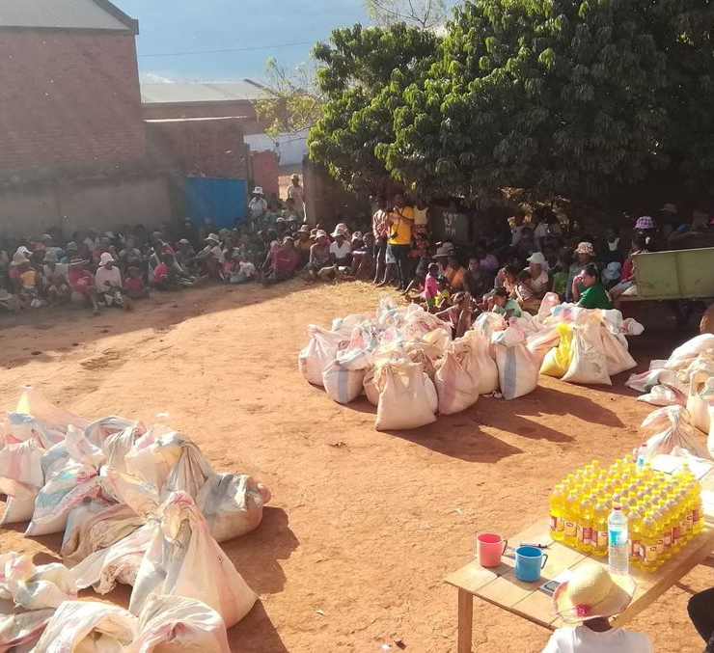
EVERY STAGE OF LIFE
Investing in people
We serve people at different stages of life.
CHILDREN
YOUTH
FAMILIES
PEOPLE IN NEED
Growing in faith, learning, and confidence.
Discovering identity, purpose, and direction.
Growing in faith, responsibility, and resilience.
Finding dignity, hope, and opportunities.
Every person matters. Every life has potential.
MANIFEST • MADAGASCAR
09
Notes:
We invest in people at different stages of life. Children grow in faith, learning, and confidence. Young people discover identity, purpose, and direction. Families grow in faith, responsibility, and resilience. People in need find dignity, hope, and new opportunities. The programmes may look different for each group, but the conviction remains the same: every person matters, and every life has potential. Long-term transformation grows when people are supported according to their season and encouraged to support others.

Slide 10
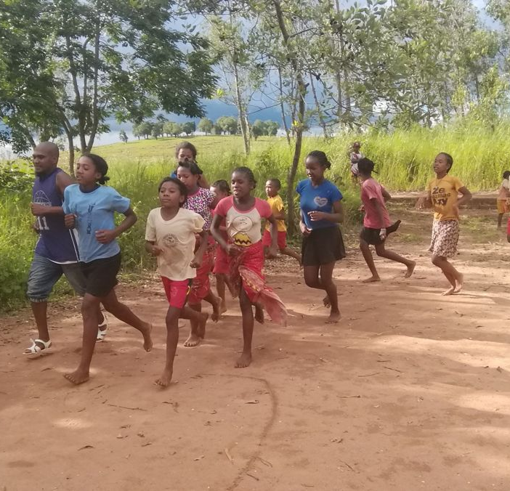
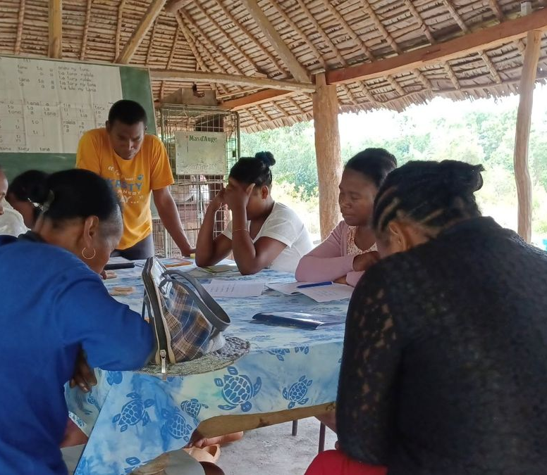
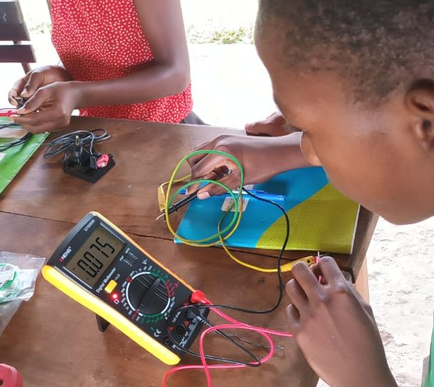
TEACH • EQUIP • EMPOWER
Education as a door to opportunity
We believe education can open doors.
SPORT — Building teamwork, discipline, confidence, and leadership through football and other sports.
1
LITERACY — Helping people read, write, and gain confidence.
2
ACADEMIC SUPPORT — Helping children and young people grow in their studies.
3
LANGUAGES — Opening access to communication and new opportunities.
4
DIGITAL & CODING — Preparing young people for a changing world through digital and technical skills.
5
TECHNOLOGY & ELECTRONICS — Developing practical and future-oriented skills.
6
COOKING & PASTRY — Turning skills into creativity and potential income.
7
TEACH. EQUIP. EMPOWER.
MANIFEST • MADAGASCAR
10
Notes:
Education is one of our strongest doors to opportunity. Sport builds teamwork, discipline, confidence, and leadership. Literacy helps people read, write, and participate with confidence. Academic support strengthens children and young people in their studies. Languages open communication and opportunity. Digital skills, coding, technology, and electronics prepare young people for a changing world. Cooking and pastry-making can turn creativity into practical income. Together these activities reflect our approach: teach, equip, and empower people with skills that serve both life and community.

Slide 11
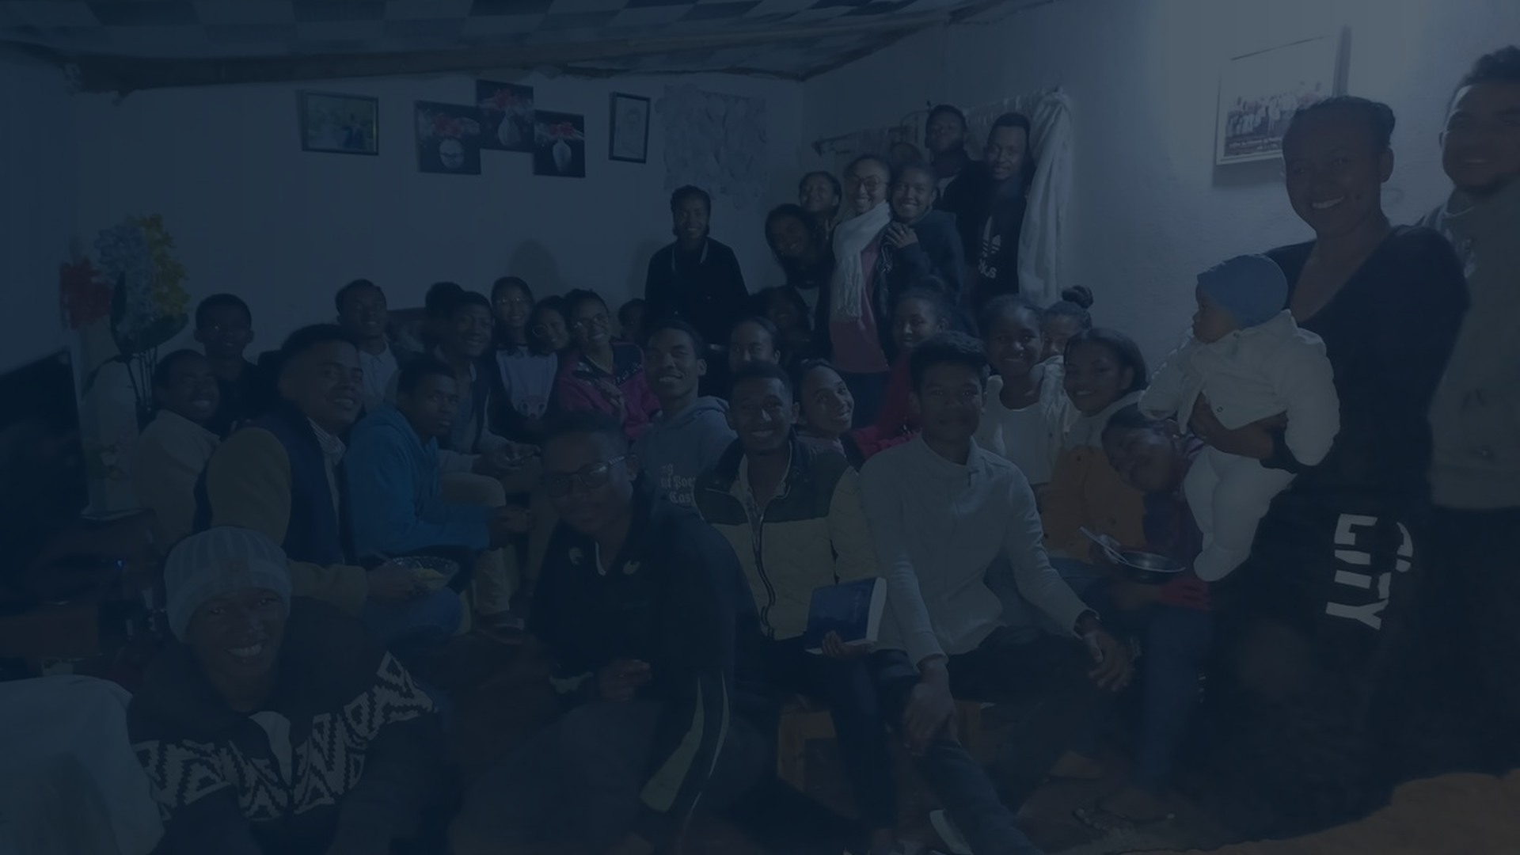
TRANSFORMATION MULTIPLIED
A movement of people
We dream of seeing transformed people become
channels of transformation.
TRANSFORMATION
A young person who leads.
RECEIVED
1
2
A family that strengthens others.
↓
3
A skilled person who creates opportunities.
TRANSFORMATION
4
A servant of God who is renewed and equipped.
MULTIPLIED
5
A community that becomes a blessing to others.
Teach. Equip. Empower.
“I have come that they may have life, and have it abundantly.” — John 10:10
MANIFEST • MADAGASCAR
11
Notes:
Our dream is not simply to run programmes. We want transformed people to become channels of transformation: a young person who leads, a family that strengthens others, a skilled person who creates opportunities, a servant of God who is renewed and equipped, and a community that becomes a blessing to others. This is transformation received and transformation multiplied. With God’s help and the partnership of people who share this vision, we will continue to teach, equip, and empower.

Slide 12
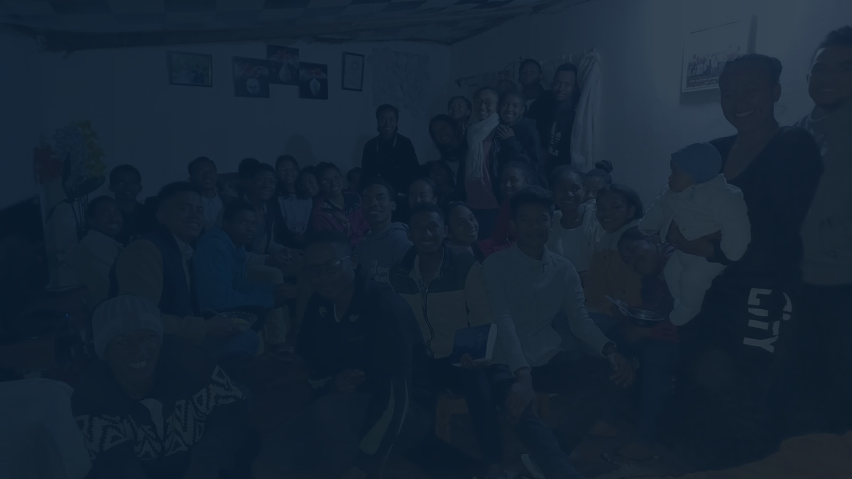
CLOSING • WITH GRATITUDE
SOLI DEO GLORIA
♥
TO GOD ALONE BE THE GLORY
THANK YOU
This is not our story. It is His story.
FOR LISTENING
We plant. We water. We serve. We pray.
But God gives the growth.
Thank you for your time, your prayers,
and your encouragement.
“Not to us, LORD, not to us,
but to Your name be the glory.”
All glory belongs to God.
PSALM 115:1
MANIFEST • MADAGASCAR
12
Notes:
As we close, we give all glory to God. This is not our story; it is His story. We plant, we water, we serve, and we pray, but God gives the growth. Thank you sincerely for listening, for your time, for your prayers, and for your encouragement. May everything MANIFEST does continue to honour God and bring hope, dignity, and opportunity to the communities we serve.

